Slide 1
S17 Phys 3650
Lecture 1
Notes About Basic Measurement Devices

Slide 2
A Familiar Example: Voltmeters
- how do they work? (i.a.)
- what could go wrong? (i.a.)
Source: Measurement, Instrumentation and Sensors Handbook

Slide 3
DC Moving Coil Voltmeters
What could go
wrong? (i.a.)

Slide 4
DC Galvanometer

Slide 5
Electronic meters
- analog
- with rectifier
- digital
- with ADC
- integrating/ non-integrating
- dual slope

Slide 6
Rectifier-based

Slide 7
Digital Voltmeters
What could go wrong?
(i.a.)
dual slope

Slide 8
Or … measure V with oscilloscope
- when to do that? (i.a.)
What could go wrong?
(i.a.)

Slide 11
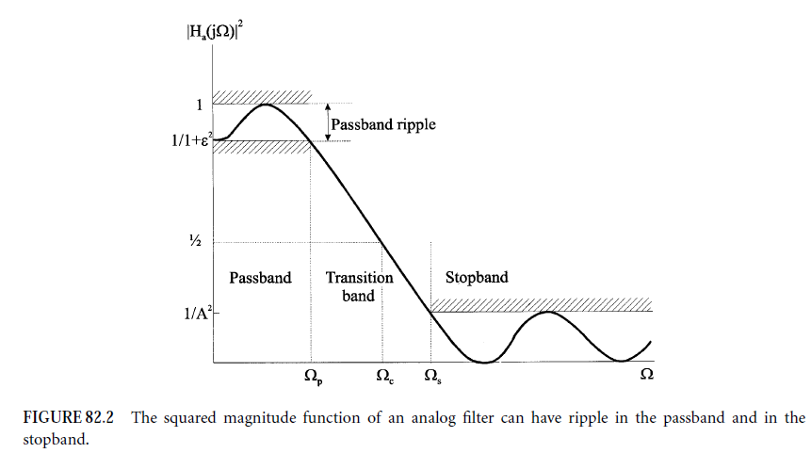
Filters
Four basic filter types:
Lowpass filters
Highpass filters
Bandpass filters
Bandstop filters
How do filters work? (i.a)
What could possibly go wrong? (i.a.)
Bessel filters
Elliptic filters
Chebyshev filters
Butterworth filters

Slide 12
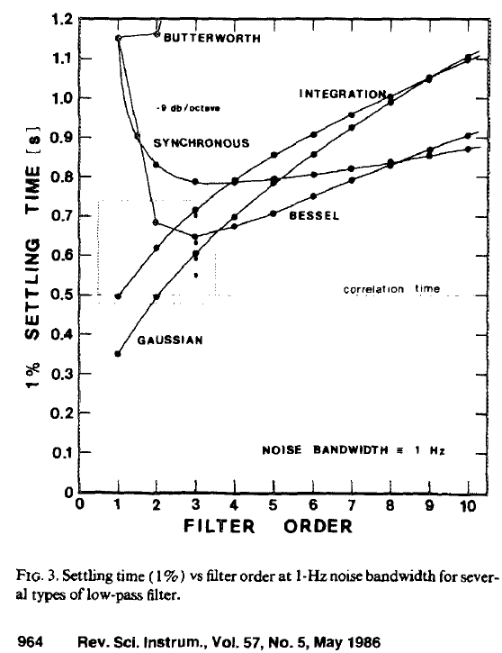
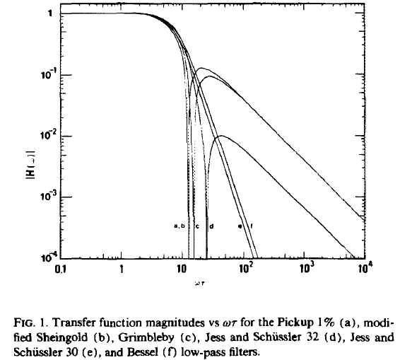

Slide 13
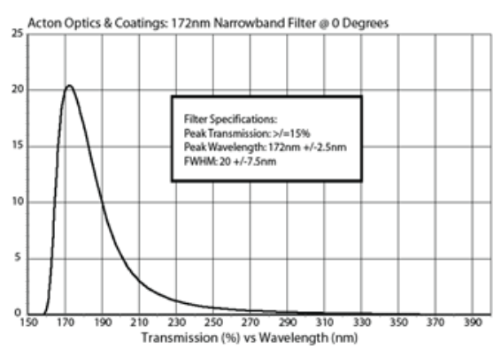
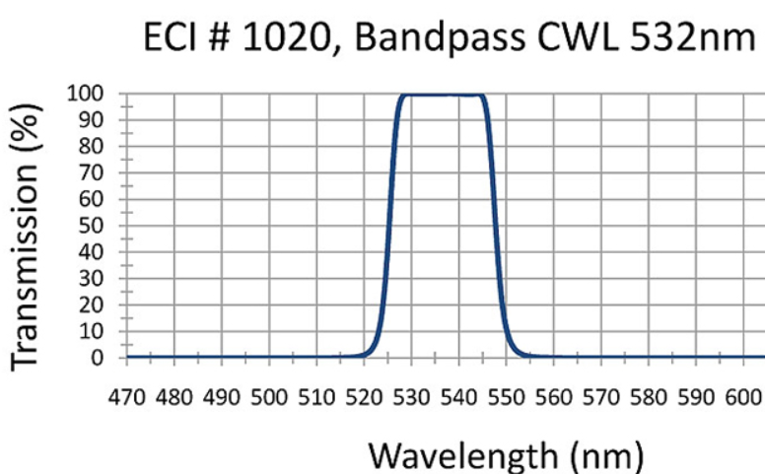
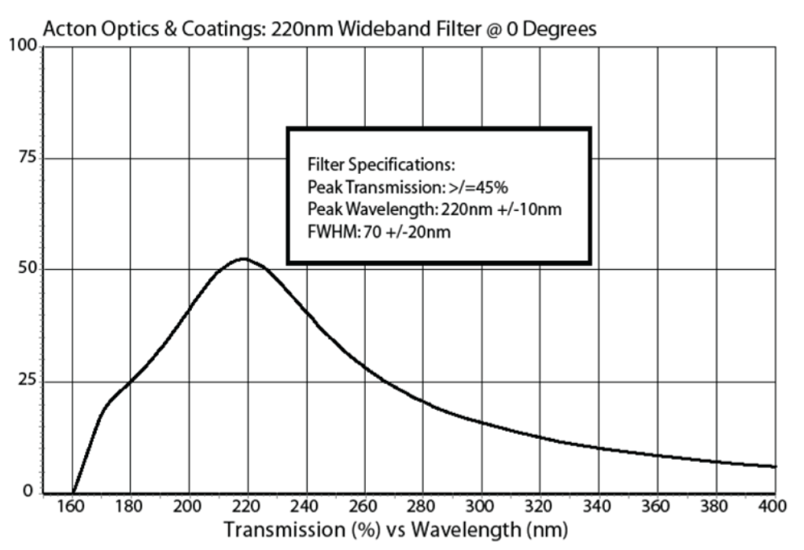
Examples Optical Filters
(EvaporatedCoatings.com)

Slide 14
Signal to Noise Ratio – quantifying data vs. noise
Also known as SNR or S/N = Signal power/ noise power [dB] = (V_rms,sig)^2/(V_rms,noise)^2
Improving S/N
- use lock-in amp to confine signal in very narrow bandwidth & filter signal to the very narrow
bandwidth, eliminating most of the broadband noise
- increasing experiment runtime; what increase makes sense depends on
data statistics (Gaussian, Poisson, …)

Slide 15
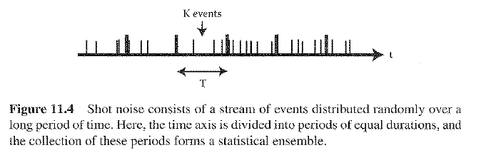
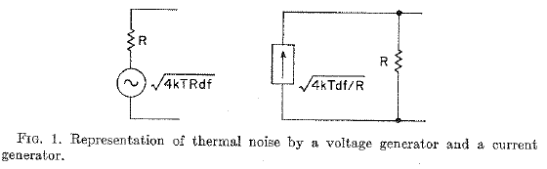
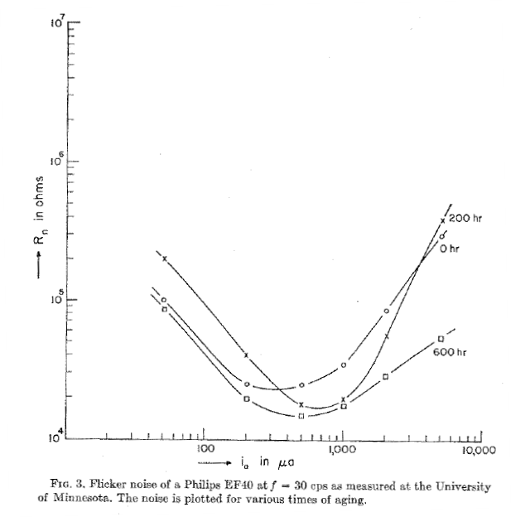
Fluctuations in devices : this is what goes wrong just
by switching the device on
Thermal fluctuations – Nyquist Noise
- Brownian Motion
- Shot Noise
Noise in Electronic Devices
(1) Electronic noise: purely statistical fluctuations inherent in device operation
- Shot noise in vacuum tubes
- Thermal or Johnson noise in conductors
(2) Modulation noise: fluctuation in quantities which control avg. characteristics of device
- Flicker noise in cathodes
- Current noise in semiconductors

Slide 16
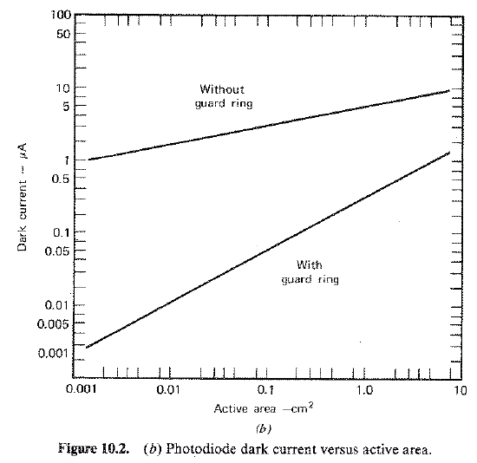
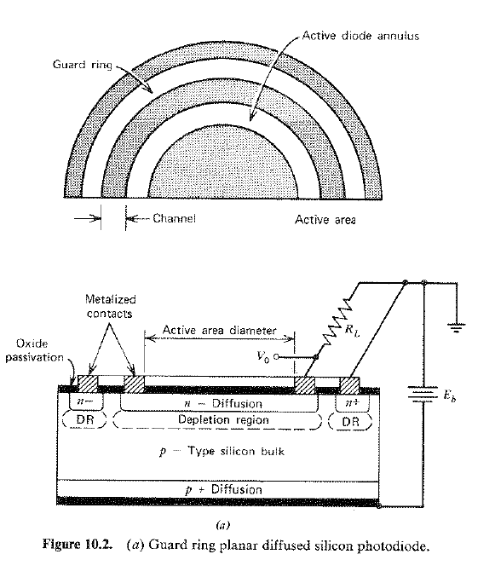
Example Dark Current in Photodiodes
Courtesy: van der Ziel ‘Noise in Measurements’

Slide 17
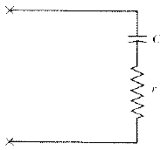
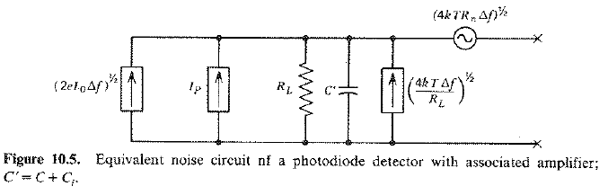
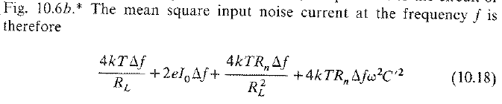
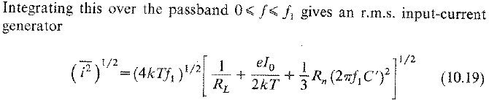
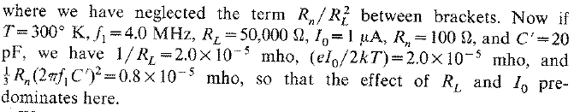
Equivalent circuit
photodiode alone
Amplifier introduces noise (vdZiel)
Giving a noise power 3 times better than
low impedance input ~ 2.2 10^-9 [W]

Slide 18

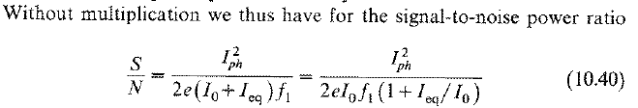
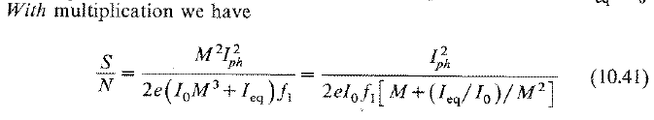

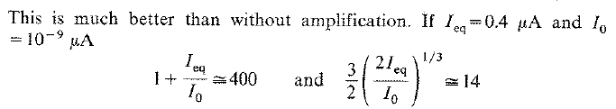
Example avalanche/photomultiplier
Hole-electron pairs are generated at random and independently: Shot noise
Total noise over all stages
where M = 1/(1-p) and p no. of e—h pairs
Improvement S/N 29 times

